Slide 1
HTTPS:
HTTP over SSL.
Combination of HTTP and SSL.
Makes secure communication between Web browser and Web Server.
It is built into modern Web browser.
URL https:// Port 443
http:// Port 80
When HTTPS is used, the following elements of the communication are encrypted.
URL of the requested document
Contents of the document
Cookies
Contents of HTTP header
Contents of browser form

Slide 2
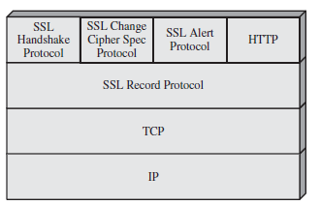
Connection Initiation
  In HTTPS, the agent act as the HTTP client also acts as the TLS client.
  The client initiates a connection to the server on the appropriate port and then sends the ClientHello to begin the handshake.
  When the handshake has finished, the client may then initiate the first HTTP request.
  All HTTP data is to be sent as TLS application data.

Slide 3
Connection Closure:
  An HTTP client or server can indicate the closing of a connection by including the following line in an HTTP record: Connection: close.
  This indicates that the connection will be closed after this record is delivered.

Slide 4
IP Security:
It is implemented above the Internet layer and below the transport layer in
TCP/IP Protocol.
Sender
Receiver
Original Message
Original Message
Application
Transport
IP Sec
Internet
Data Link
Application
Transport
IP Sec
Internet
Data Link
Transmission Medium

Slide 5

IP Security Architecture:
The documents are issued in November 1998 and they are
RFC 2401 : Specifies the overview of security architecture.
RFC 2402 : Describes the packet authentication.
RFC 2406 : Describes the packet encryption.
RFC 2408 : Specifies Key Management Capabilities.
The documents are divided into seven groups:
Architecture
ESP Protocol
AH Protocol
Encryption Algorithm
Authentication Algorithm
DOI
Key Management

Slide 6
Architecture:
This document covers the general concepts, security requirements, definitions and
mechanisms defining IP Sec technology.
Encapsulating Security Payload:
This document covers the packet format, general issues related to the use of ESP for encryption and optional authentication.
Authentication Header:
This document covers the packet format, general issues related to the use of AH for authentication.
Encryption Algorithm:
This document describes how the encryption algorithms are used for ESP.
Authentication Algorithm:
This document describes how the encryption algorithms are used for AH.
Key Management:
This document describes the key management issues.
Domain of Interpretation:
This document contains value needed for other documents to relate to each other.

Slide 7
IP Security offers two main services:
Confidentiality
Authentication
Two protocols are used to provide security:
Authentication Header Protocol
AH provides authentication, integrity and an optional anti-replay service.
AH is inserted between the IP Header and any subsequent packet contents.
Encapsulating Security Payload Protocol
ESP provides data confidentiality.
ESP will be inside the AH. ie., Encryption happens first and then authentication.
On receipt of the IP packet, the receiver processes the AH first and then extracts the key and algorithm associated with ESP and decrypt the contents.
Both AH and ESP can be used in one of the two modes.

Slide 8
AH and ESP modes of Operation
Tunnel Mode
Transport Mode
X
P1
P2
Tunnel
Proxy
Proxy
Y
Concept of Tunnel Mode
Network 1
Network 2

Slide 9
Payload
P1 P2 X Y
External IP Header
Internal IP Header and Encrypted
Implementation of Tunnel Mode
In tunnel mode, an encrypted tunnel is established between two hosts.
Suppose X and Y are two hosts, want to communicate with each other using
IPSec tunnel mode.
They identify their respective proxies, say P1 and P2 and a logical encrypted
channel is established between P1 and P2.
X sends its transmission to P1, the tunnel carries the transmission to P2 and then
P2 forwards it to Y.

Slide 10
Transport Layer
Transport Layer payload
Network Layer
IP H
IP Payload
IP Sec H
IP Sec Payload
IP Sec T
New IP H
New IP Payload
IPSec Tunnel Mode

Slide 11
In tunnel mode, IPSec protects the entire IP datagram.
It takes an IP datagram , adds IPSec header and trailer and encrypts the whole
thing.
It then adds new IP header to this encrypted datagram.
Tunnel mode is normally used between two routers, a host and a router or a
router and a host.

Slide 12
Transport Layer
Transport Layer payload
Network Layer
IP Sec H
IP Sec Payload
IP Sec T
IP H
New IP Payload
IPSec Transport Mode

Slide 13
Transport mode does not hide the actual source and destination addresses.
They are visible in plain text, while in transit.
IPSec takes the transport layer payload, adds IPSec header and trailer, encrypt the whole thing and then adds the IP Header.
In this IP Header is not encrypted.
Transport mode is useful when we are interested in a host-to-host encryption.

Slide 14
Internet Key Exchange (IKE) Protocol:
It is used for the Key management procedure.
IKE is used to negotiate the cryptographic algorithms to be used by AH and ESP.
IKE is the initial phase of IPSec, where the algorithms and keys are decided.
After the IKE phase only, the AH and ESP take over.
Security Association:
The output of the IKE phase is SA.
It is an agreement between communicating parties about factors such as version, mode of operation, Cryptographic algorithms, cryptographic keys, lifetime of keys, etc.,
Once this is done, Both AH and ESP protocols make use of SA for their actual operation.

Slide 15
If both AH and ESP are used, each communicating party requires two sets of
SA: One for AH and another one for ESP.
Moreover, SA is simplex (ie., unidirectional)
Both communicating parties must allocate some storage area for storing the SA information at their end.
--- Standard storage area called Security Association Database (SAD).
Each communicating party requires maintaining its own SAD.

Slide 16
Contents of SAD:
Sequence Number Counter: A 32-bit value used to generate the Sequence Number field in AH or ESP headers.
Sequence Counter Overflow: A flag indicating whether overflow of the Sequence Number Counter should generate an auditable event and prevent further transmission of packets on this SA.
Anti-Replay Window: Used to determine whether an inbound AH or ESP packet is a replay,
AH Information: Authentication algorithm, keys, key lifetimes, and related parameters being used with AH (required for AH implementations).
ESP Information: Encryption and authentication algorithm, keys, initialization values, key lifetimes, and related parameters being used with ESP (required for ESP implementations).
Lifetime of this Security Association: A time interval or byte count after which an SA must be replaced with a new SA (and new SPI).
IPsec Protocol Mode: Tunnel, transport.
Path MTU(PMTU): Any observed path maximum transmission unit (maximum size of a packet that can be transmitted without fragmentation).

Slide 17
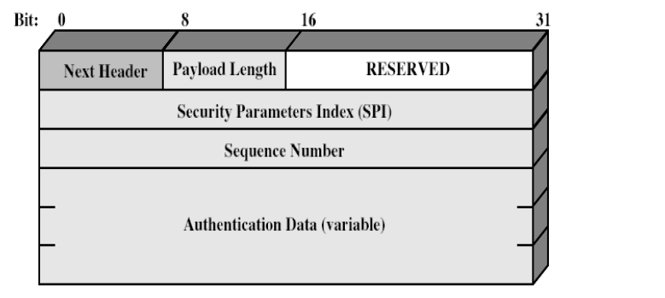
Authentication Header (AH) Format

Slide 18
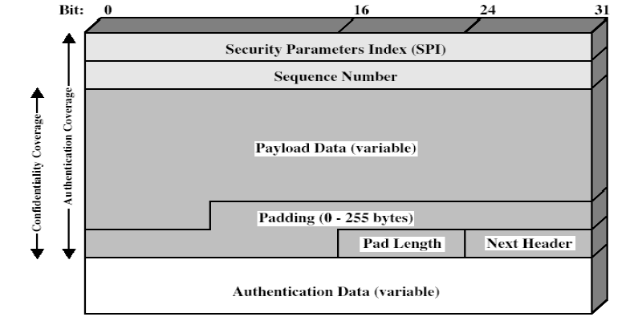
Encapsulating Security Payload (ESP) Format

